Slide 1

YouAnalytics
K.M.A.R.T. consulting
KRISSY STICHNOTE, MORGAN COPELAND, AUSTIN MCCOWAN, RAYMOND CHITAURO, TYRONE BERRY

Slide 2
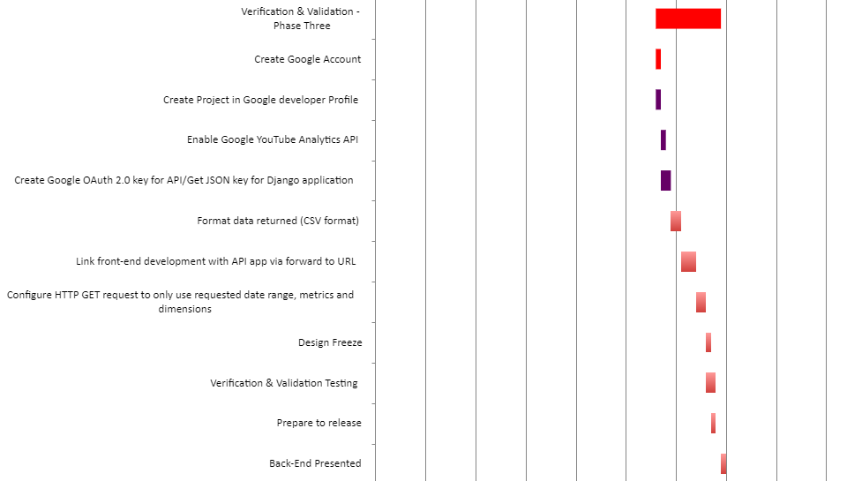
verification & Validation Phase – Phase tHree
Krissy, Project Manager
During Phase Three we worked on finalizing
our features, committing them and verifying
they will work with our product.
What you will see today
Final user interface of our system
Coding features
Live demo of YouAnalytics

Slide 3
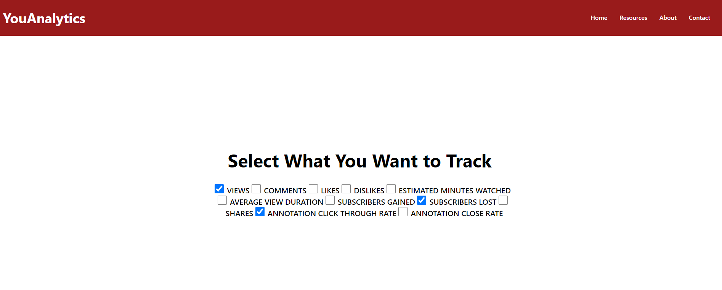
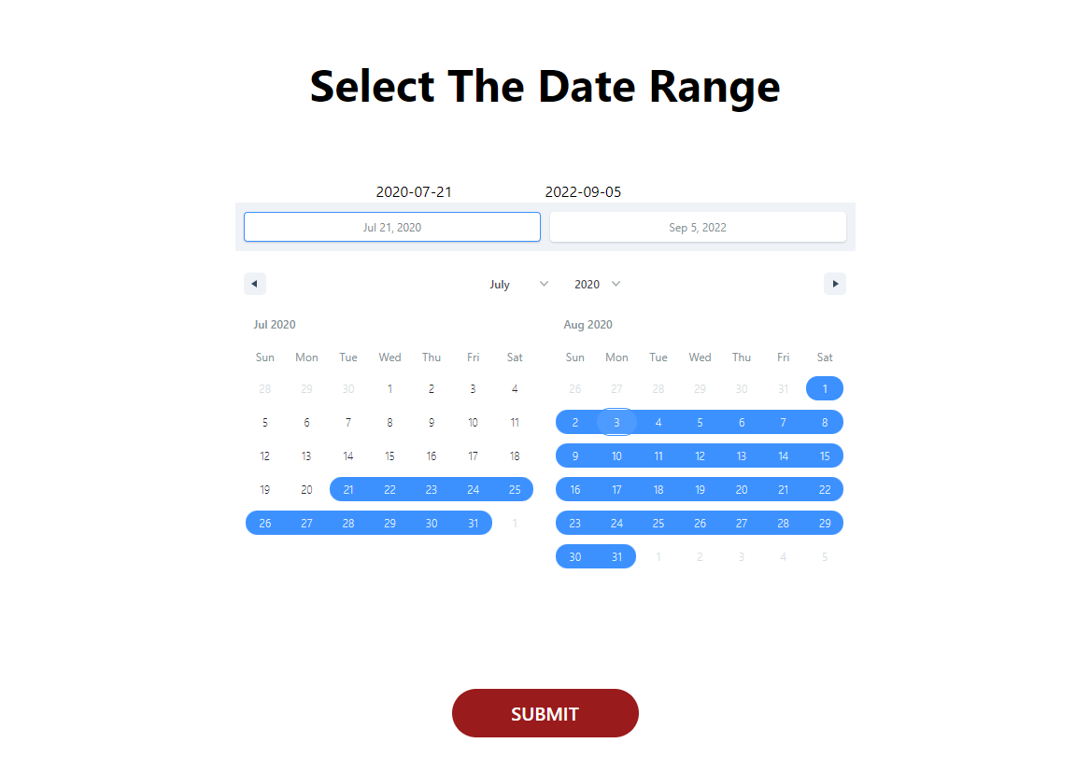
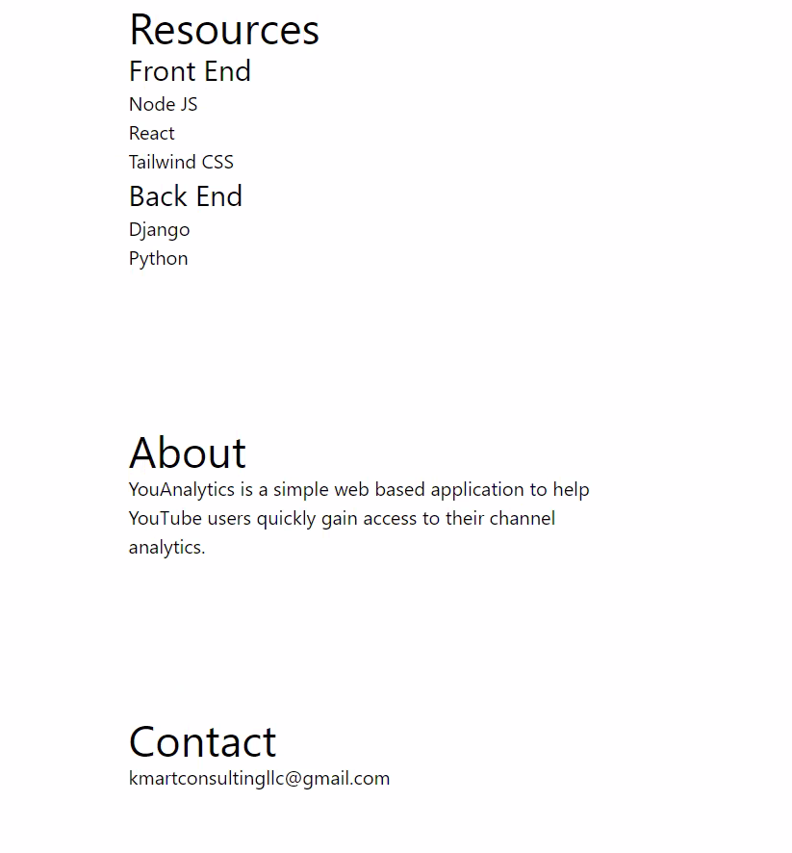
Finalized user interface Tyrone, Developer
YouAnalytics is a tool that is used for quick and simple access to information you want to track as a YouTube User.
Easily select what data you want track:
Views
Likes
Dislikes
Estimated Minutes Watched
Average View Duration
Date Range
Etc.
Front-End Resources:
Node JS
React
Tailwind CSS

Slide 4
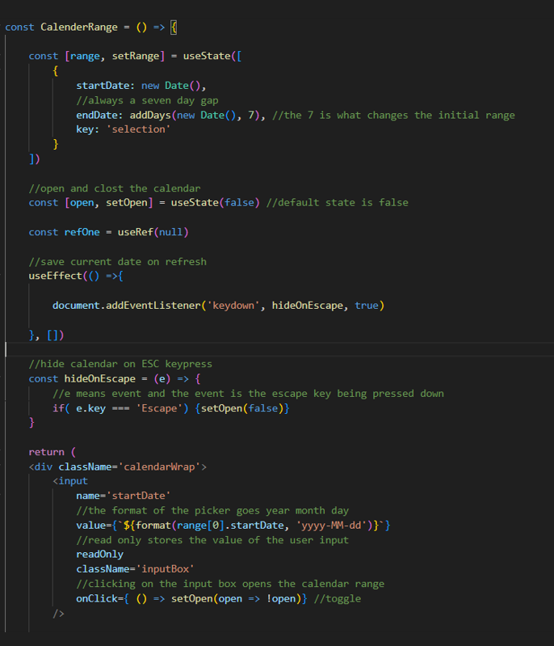
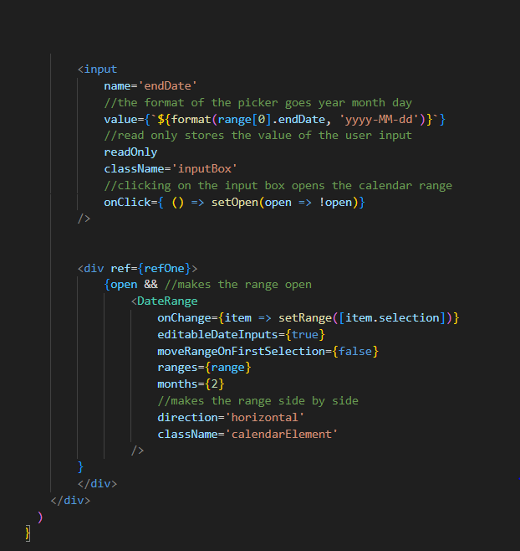
Date range selection Tyrone, Developer

Slide 5
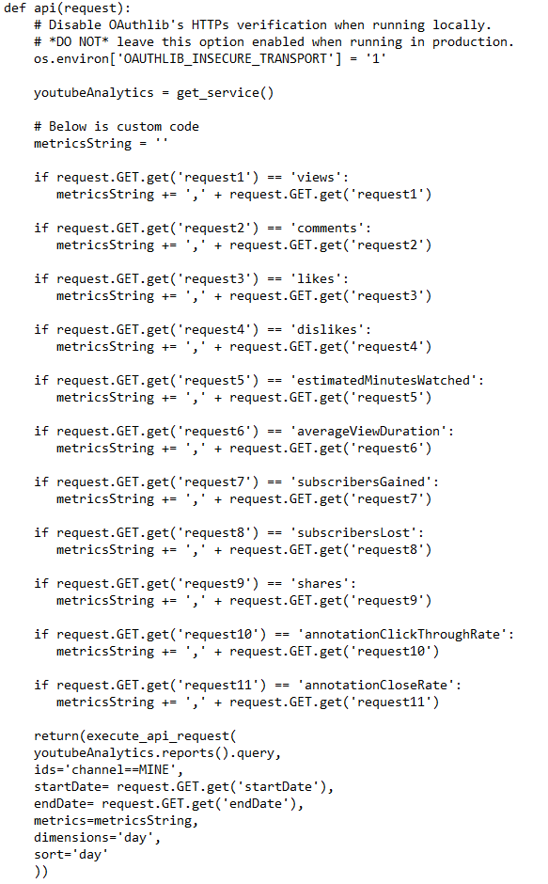
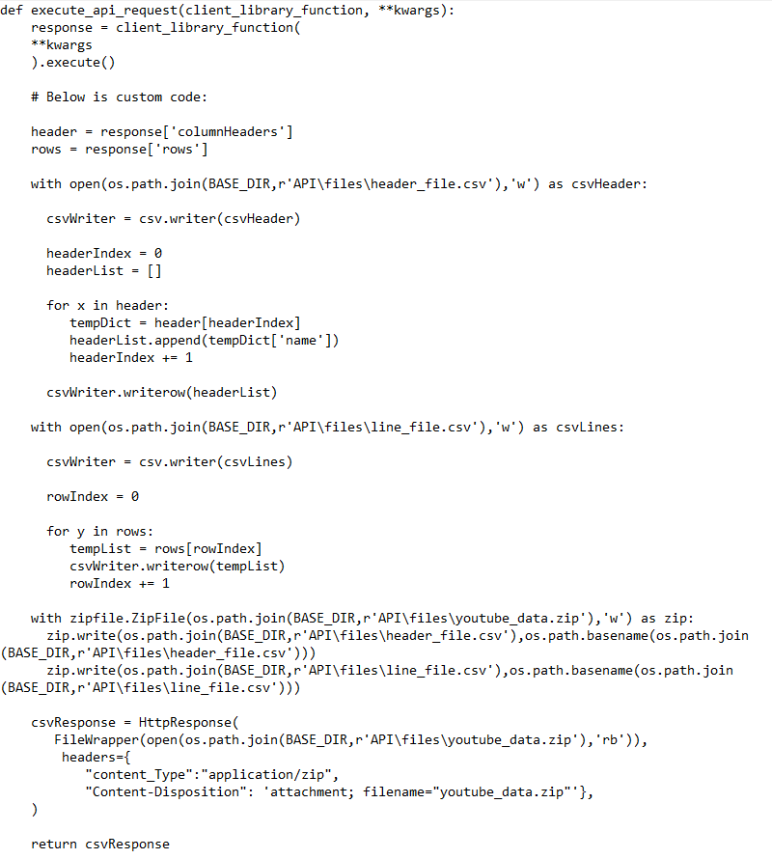
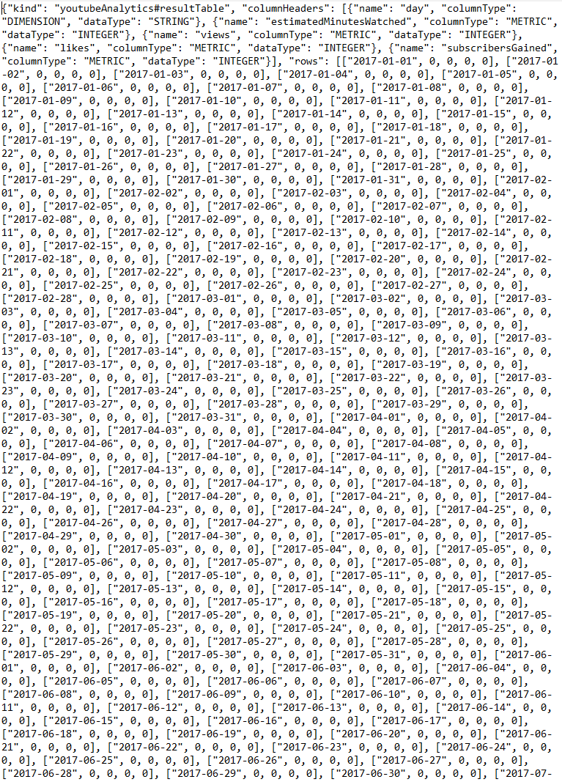
API Function Morgan, Developer
Raw results

Slide 6
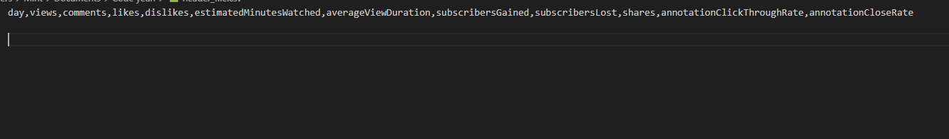
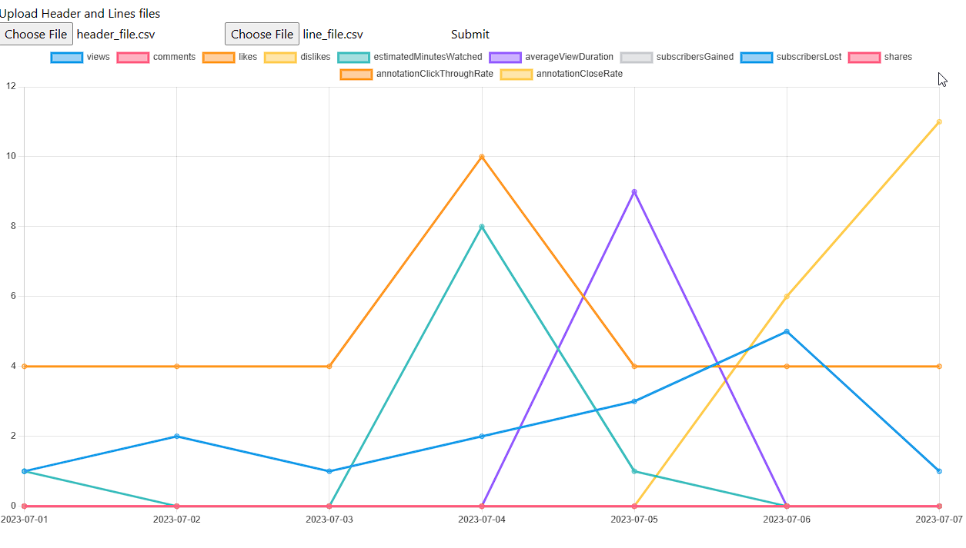
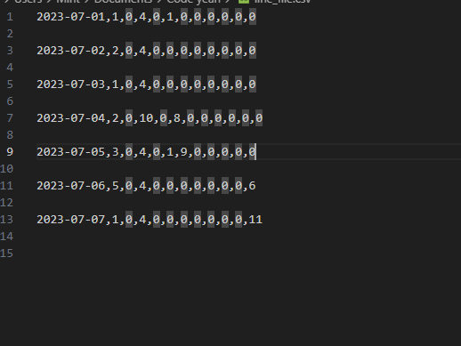
Visual Outputs Austin, Developer
Category File (i.e header_file.csv)
Content file (i.e lines_file.csv)

Slide 7
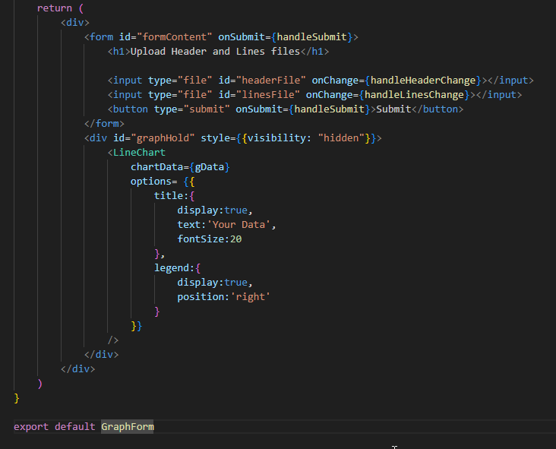
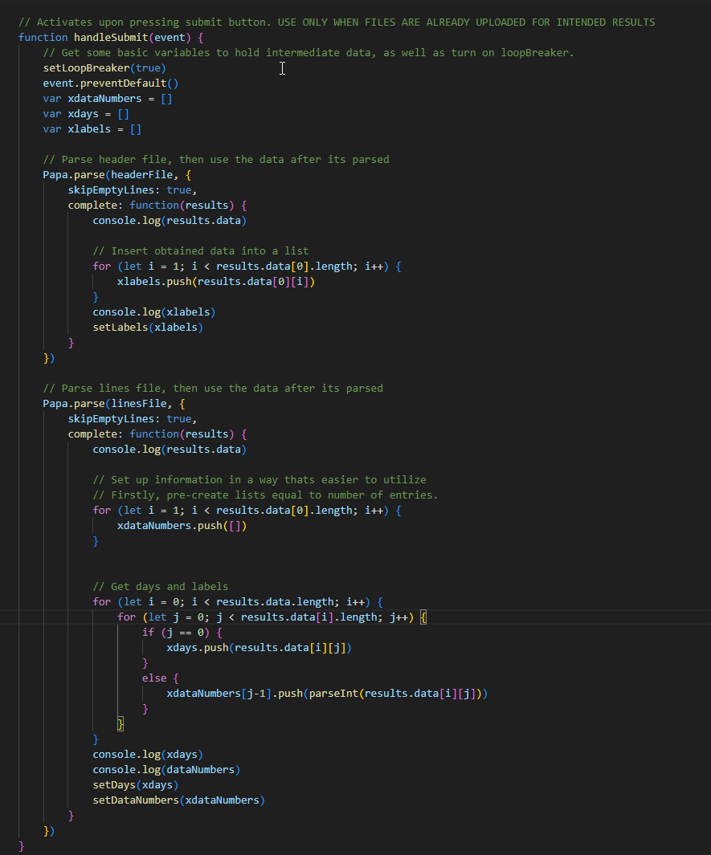
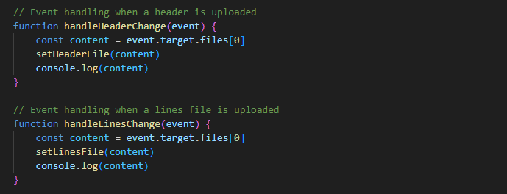
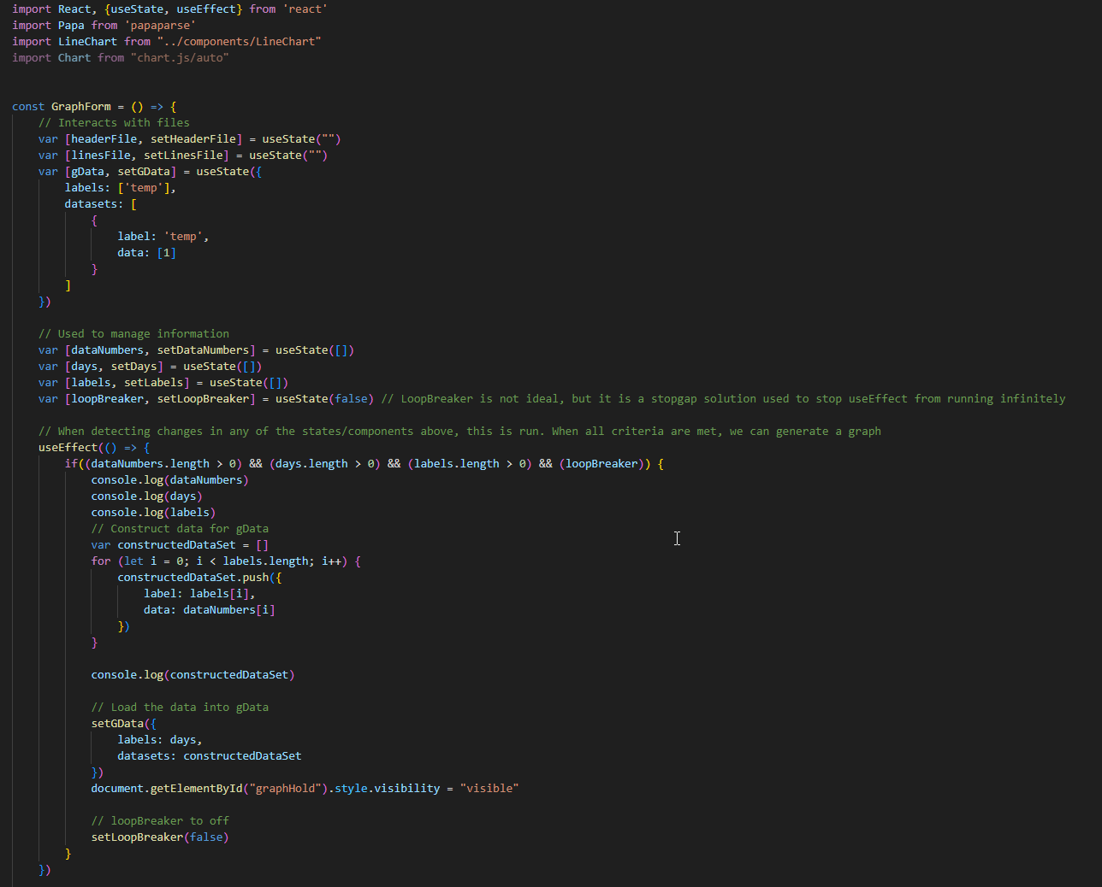
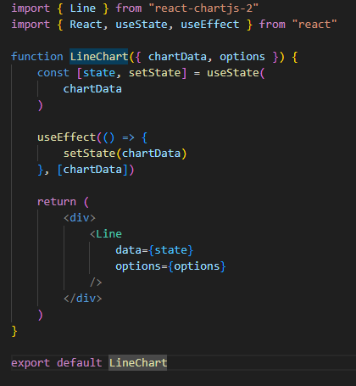
Visual Outputs Austin, Developer
3.
4.
1.
2.
5.

Slide 8

Thank You
K.M.A.R.T. Consulting
Krissy stichnote
Morgan copeland
Austin mccowan
Raymond chitauro
Tyrone berry

